Slide 1
ERTAC EGU Projection Tool Installation
Byeong-Uk Kim, Ph.D., Georgia Environmental Protection Division
Joseph Jakuta, Ozone Transport Commission
John Welch, Indiana Department of Environmental Management
Doris McLeod, Virginia Department of Environmental Quality
2015 International Emission Inventory Conference
April 13, 2014 – San Diego, CA

Slide 2
Requirement/Recommendation
Hardware
4 GB of RAM and 1TB HDD for CONUS runs
Software
Python Version 2.6 or higher, which should include SQLite 3.6 or higher
https://www.python.org/downloads/release/python-279
ERTAC EGU Projection Code Version 1.01 (Version 1.02 will be available shortly)
From the tutorial USB drive
ERTAC EGU Projection Tool Tutorial Data
From the tutorial USB drive

Slide 3
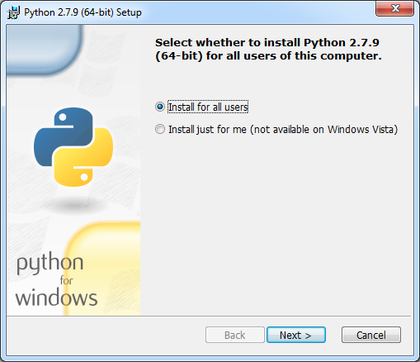
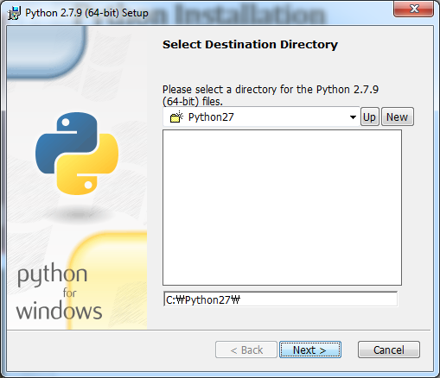
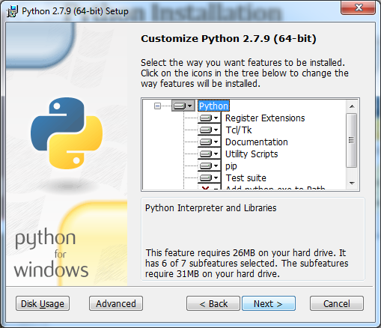
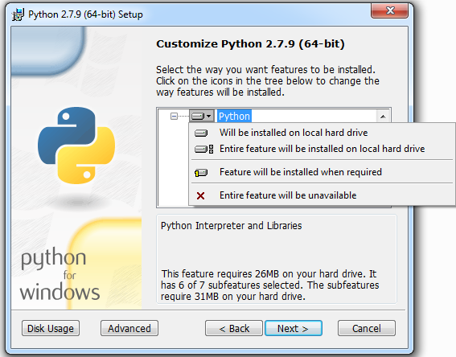
Python Installation

Slide 4
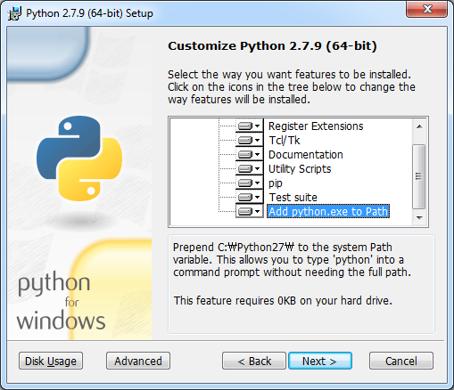
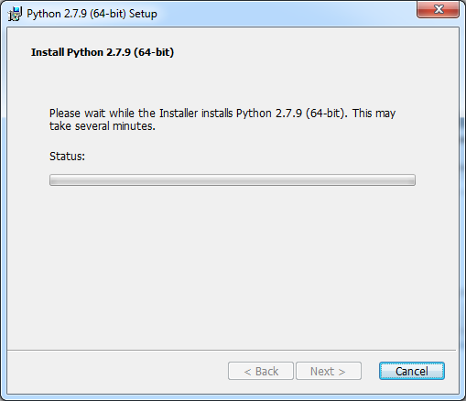
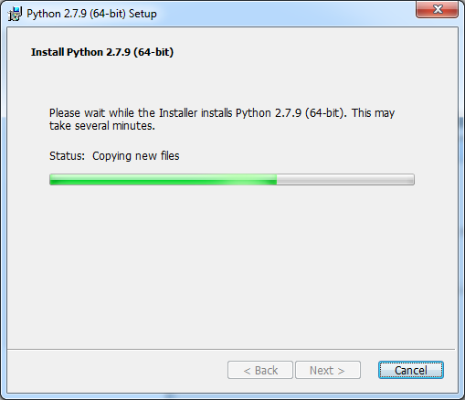
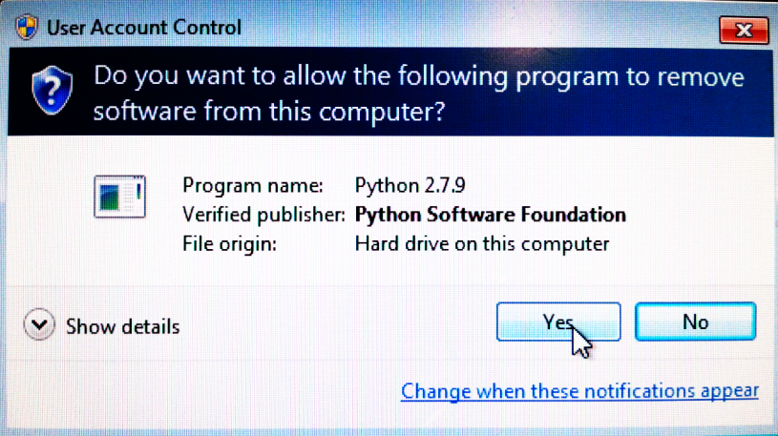
Python Installation

Slide 5
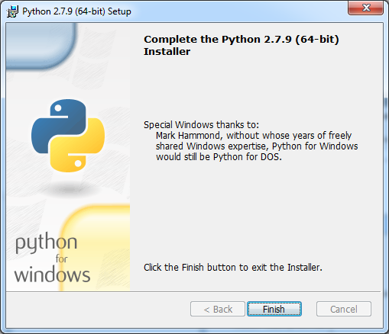
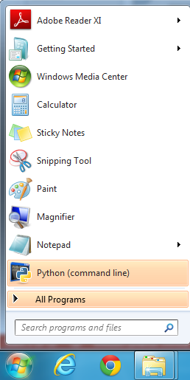
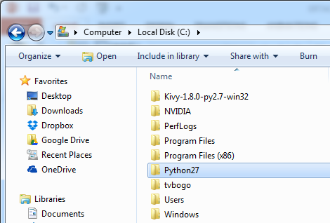
Python Installation

Slide 6
ERTAC EGU Projection Code and Tutorial Data
Copy ERTAC EGU code v1.01 into the following directory:
C:\ertac_egu\1.01
Copy the tutorial dataset into the following:
C:\ertac_egu\REG3
Test if the installation is done correctly:
Open the command window
  “Start” => type “cmd” => move to the dataset folder, or
  Press the left shift key down and right-click on the dataset folder icon => Select “Open command window here”
Type command:
  C:\ertac_egu\REG3>"C:\ertac_egu\1.01\ertac_preprocess.py" –h
  This should return the “help” menu of the code.

Slide 7
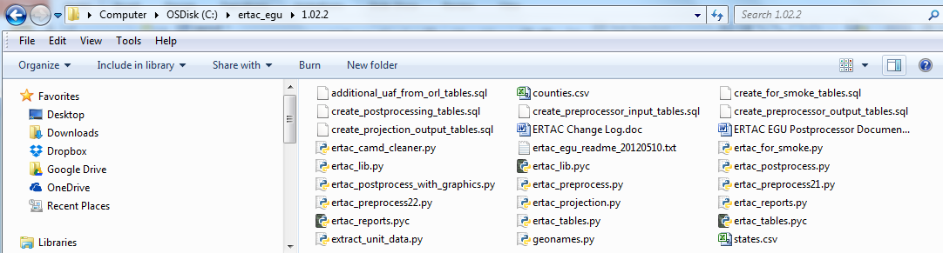
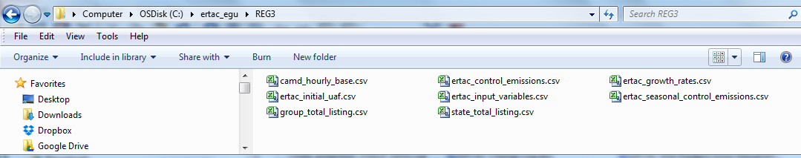
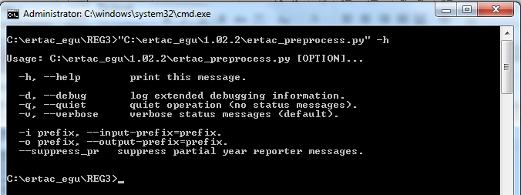
Successful Installation

Slide 8
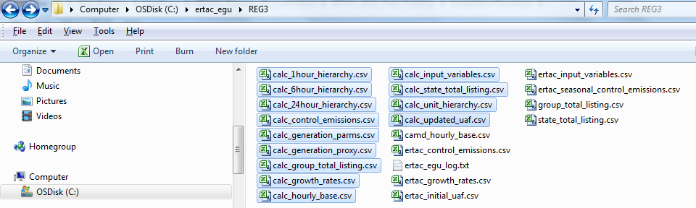
Tutorial Case - Preprocessing
In the command line window, type
  “C:\ertac_egu\REG3>"C:\ertac_egu\1.021\ertac_preprocess.py“
Wait until you see the command line prompt again.
It may take about 2-3 minutes to finish.
You should be able to see calc* files.
Review the log file before running the projection code.

Slide 9
Tutorial Case - Projection
In the command line window, type
  “C:\ertac_egu\REG3>"C:\ertac_egu\1.02.2\ertac_projection.py“
Wait until you see the command line prompt again.
It may take about 2-3 minutes to finish.
You should be able to see calc* files.
Review the log file before running the post-processing code.

Slide 10
Tutorial Case - Postprocessing
In the command line window, type
  “C:\ertac_egu\REG3>"C:\ertac_egu\1.01\ertac_postprocess.py“
Wait until you see the command line prompt again.
It may take about 2-3 minutes to finish.
You should be able to see calc* files.
Review the log file carefully.
Additional command line inputs are available for power users.

Slide 11
For Future Assistance
To read and ask support questions visit the google group - https://groups.google.com/d/forum/ertac-egu-user.
Note: anyone can read previous posts, but you must register to post questions.
To join the group:
  Sign in using your google account
    If you don’t want a full gmail email address you can sign up using your work account
  Click to apply to the group

Slide 12
Review and analysis of results

